Slide 1
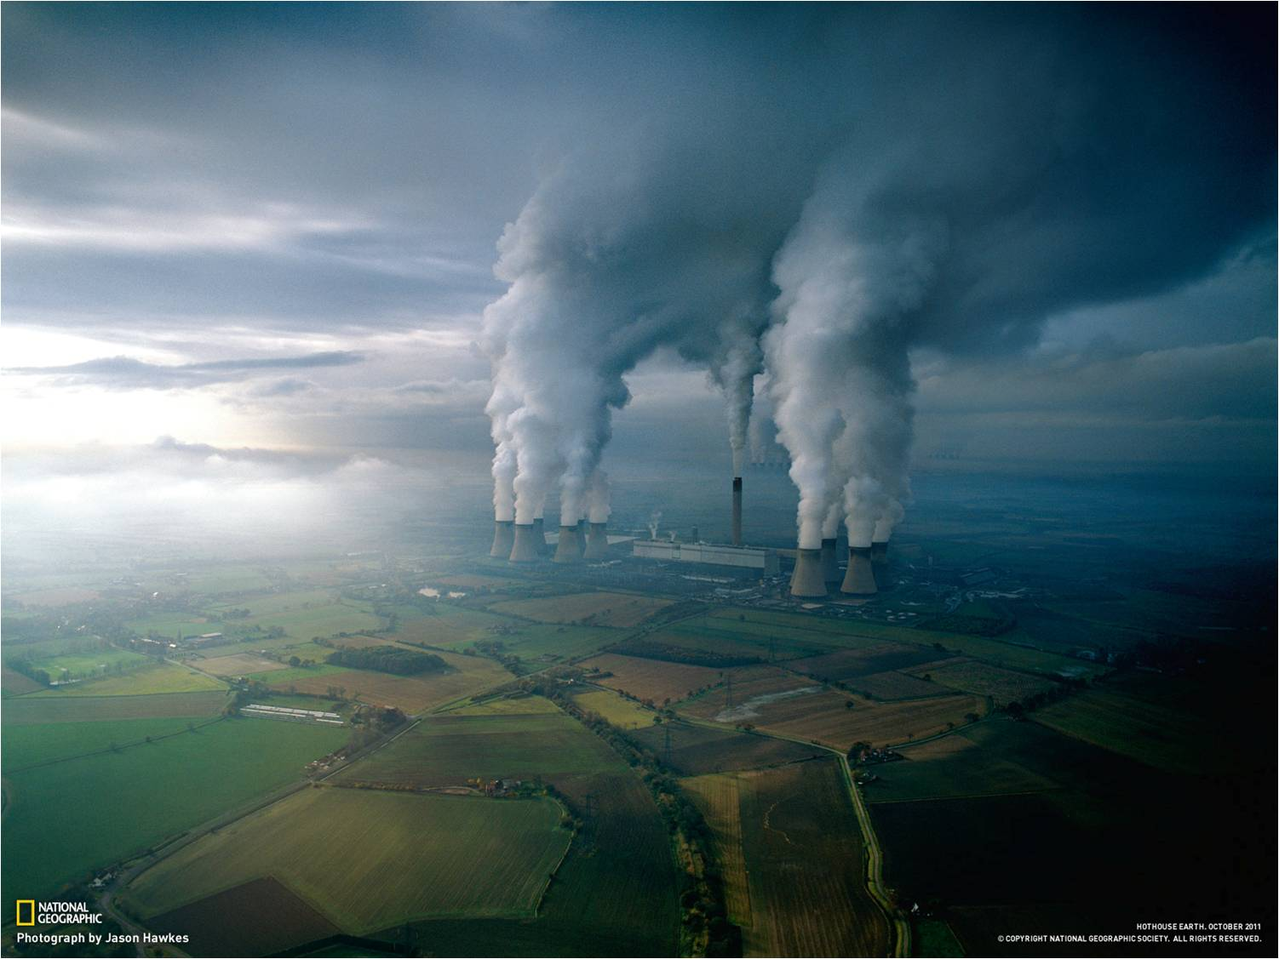


Center for Energy Efficiency – XXI
We give our energy to save yours! www.cenef.ru (499) 120-9209
Moscow, 10.11.2017
Igor Bashmakov
Is it possible to learn lessons of the future?

Slide 2
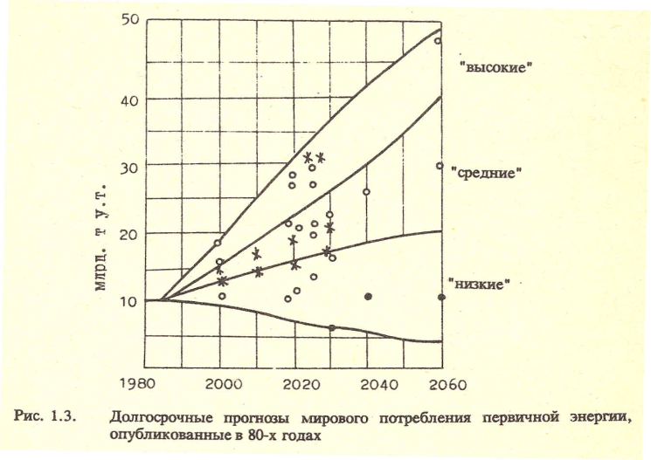
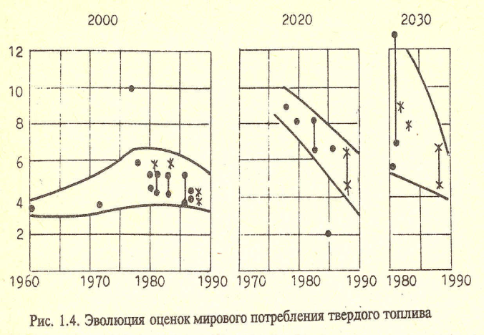
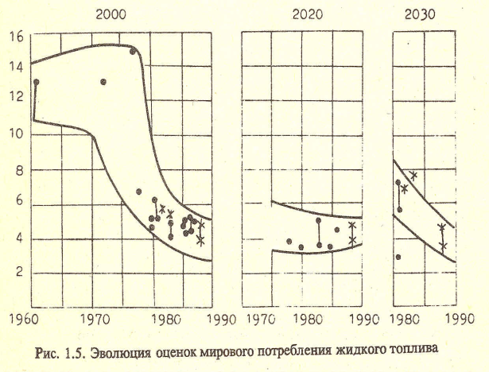
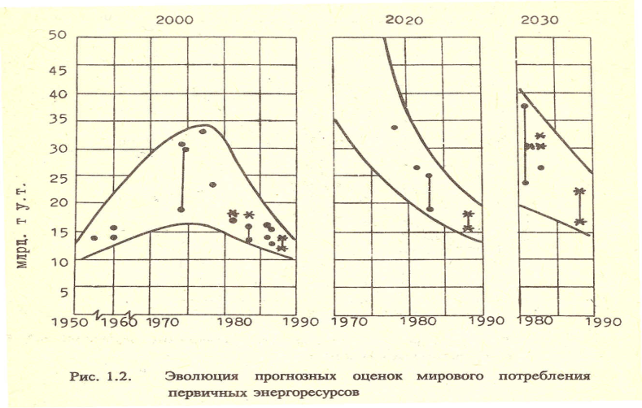
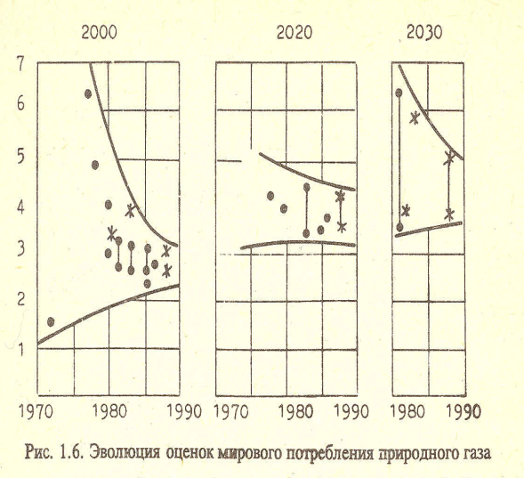
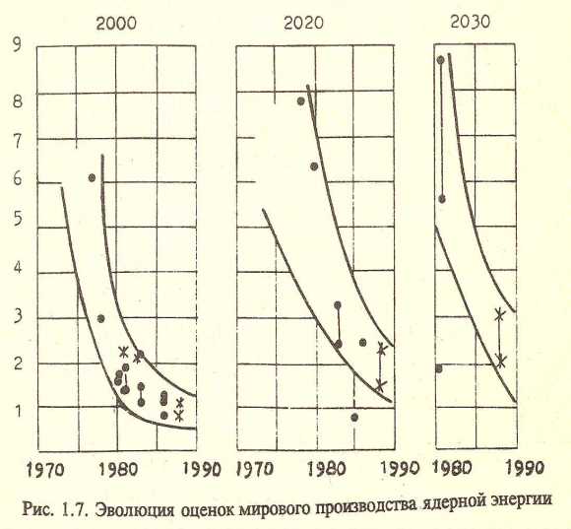
The road to the future is paved with the ruins of projections!
Historical view: 1953-1990’ projections versus reality (red lines)
Solid fuels
Liquid fuels
Evolution of TPES projections
Natural gas
Nuclear

Slide 3
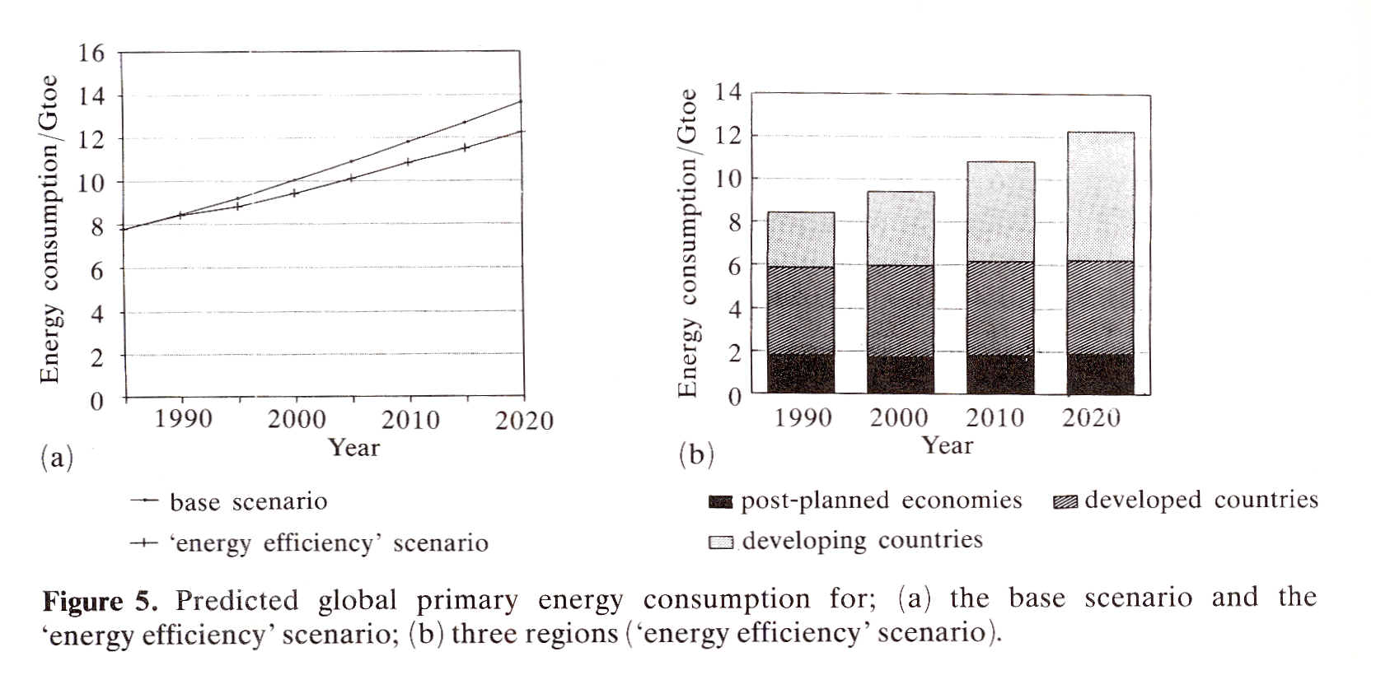
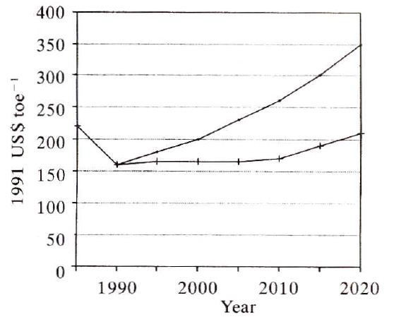
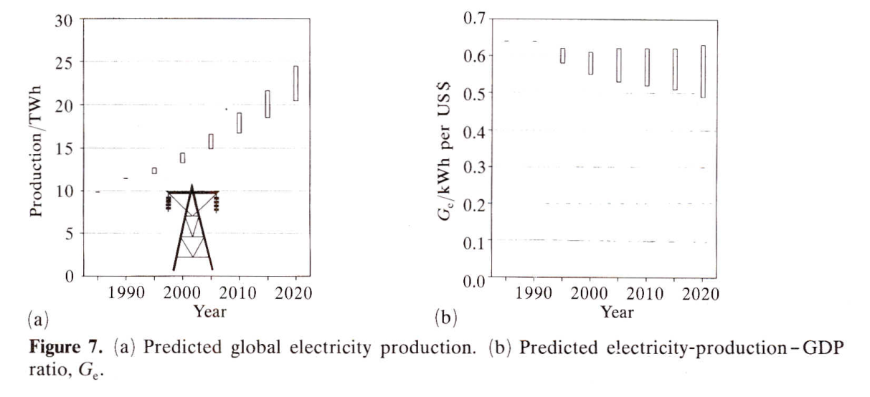
“Global energy: Lessons of the future”.
25 years from publication (1992)
Primary energy
Crude oil price $US1991
1988-1992. Key finding: oil prices will keep below the 1985 level until 2000 and will inevitably start growing thereafter
2006 -2007. Beyond 100$/barrel is not a sustainable range for oil prices. They will eventually drop to 30-40 $US and then will start growing again
Electricity generation and electricity intensity

Slide 4
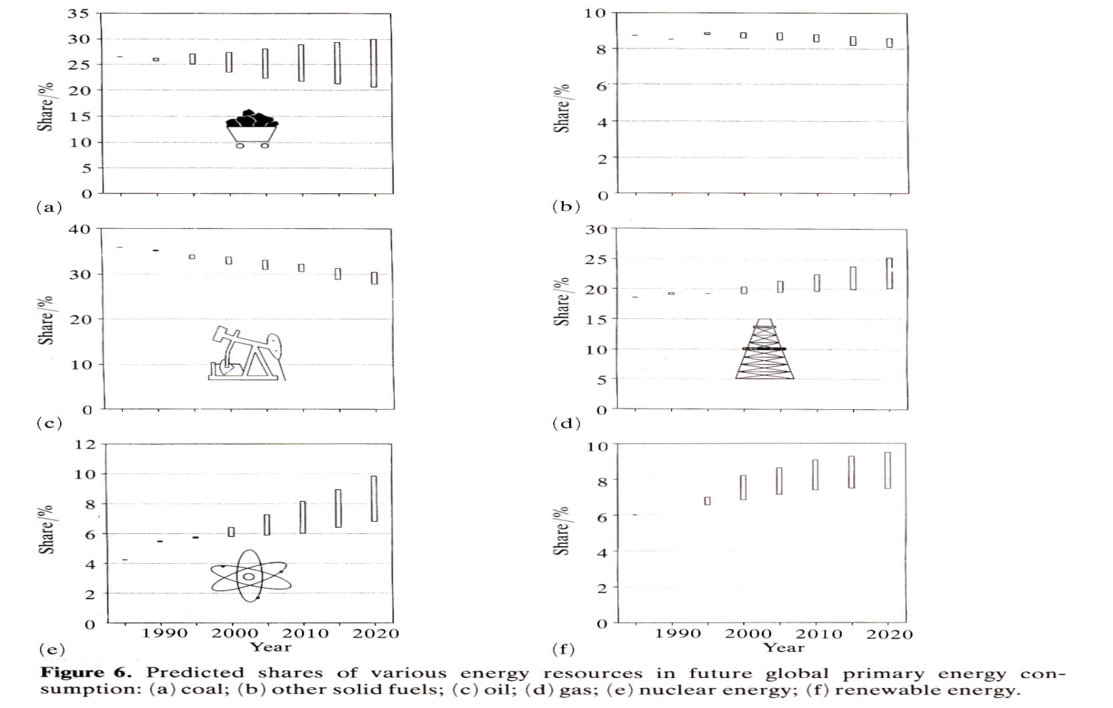
“Global energy: Lessons of the future”.
25 years from publication (1992)
Another methodology to translate power to TPES
Multiply by 3
Projections of shares of energy resources fit reality quite well

Slide 5
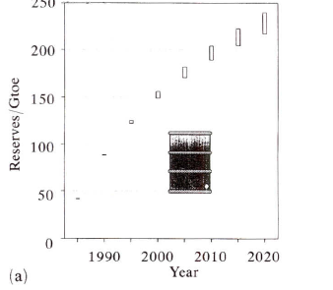
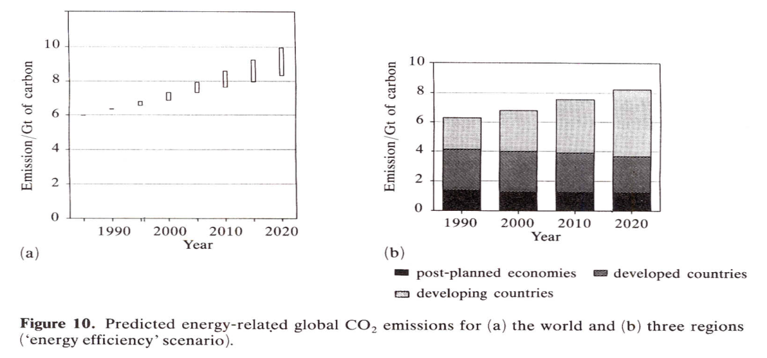
“Global energy: Lessons of the future”.
25 years from publication (1992)
Cumulative oil production plus resources sufficient to sustain last year’s production for 15 years
Can we learn lessons of the future?
Yes we can!
At least to a certain degree . . .
“Global energy: Lessons of the future”.
I. Bashmakov Ed., 1992
CO₂ emission from fuel combustion

Slide 6
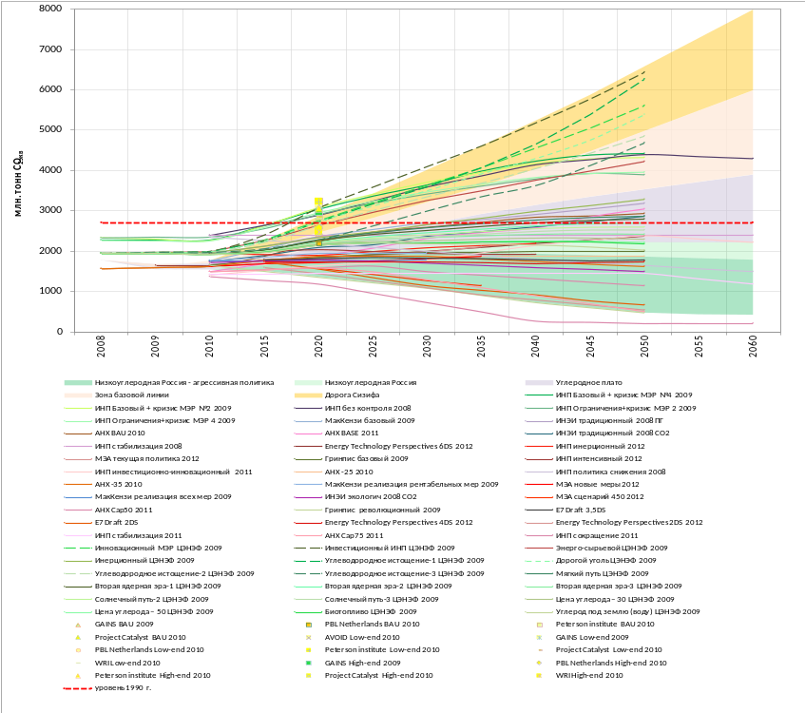
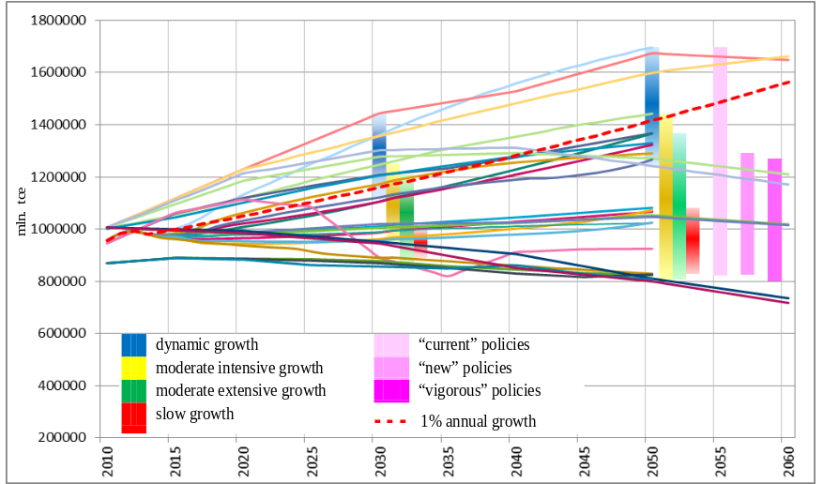
There is a certain order in the very wide ‘spaghetti’ of energy projections .
The set of projections can be structured
Projections can be organized in a data base according to assumptions and modeling techniques:
Assumptions:
Economic and population growth rates
Energy prices
Energy policies
Penetration of new technologies
Modeling and metrics:
Energy balance accounting methods
Top-down models
General equilibrium or simulation models
Bottom-up models (engineering modeling approaches)
Combination of top-down and bottom-up models
Russian energy-related GHG emission evolution trajectories to 2060 as projected by a number of research groups in 2008-2012
Primary energy consumption in Russia: 30 scenarios

Slide 7
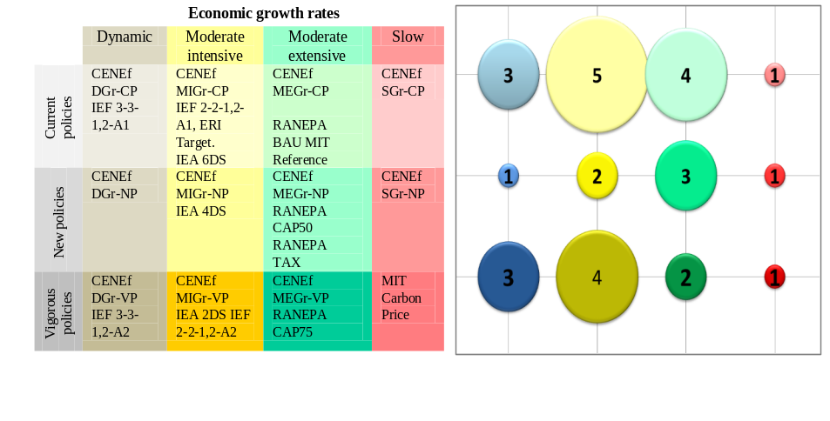
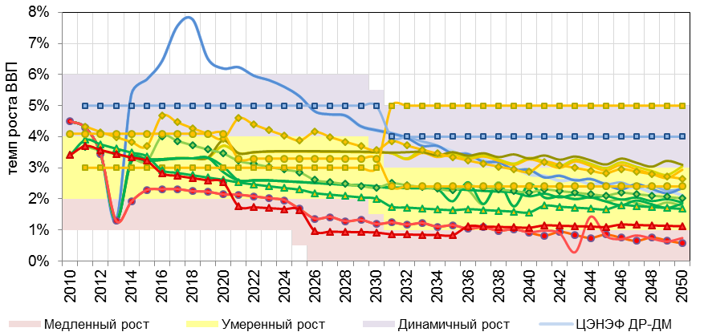
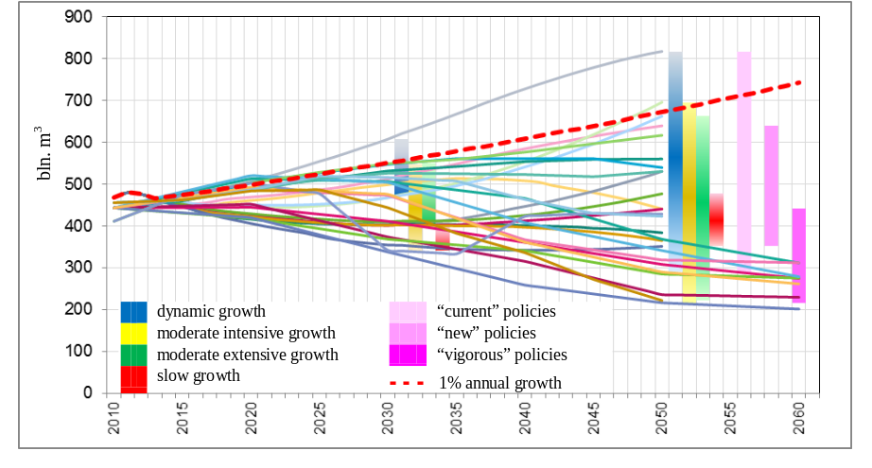
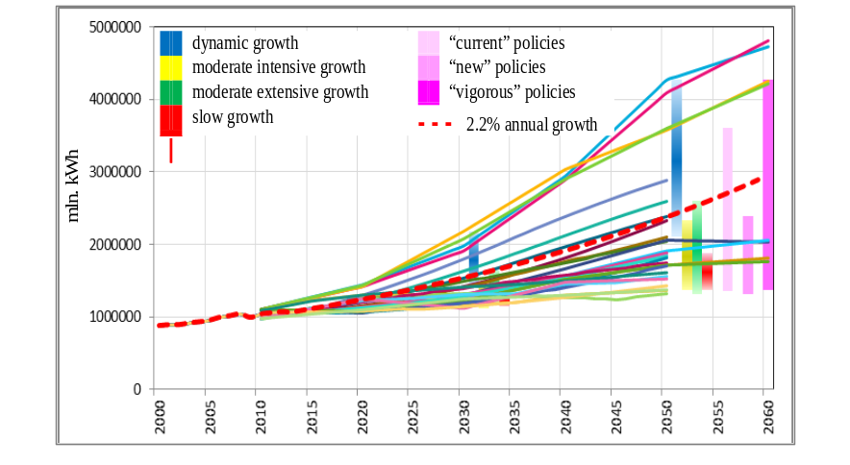
Russian recent experience in projections structuring
“Costs and Benefits of Low-Carbon Economy and Society Transformation in Russia. 2050 Perspective”. I. Bashmakov Editor
Distribution of coordinated scenarios by families
GDP growth rates
Evolution of natural gas consumption in individual scenarios
Evolution of electricity generation in individual scenarios

Slide 8
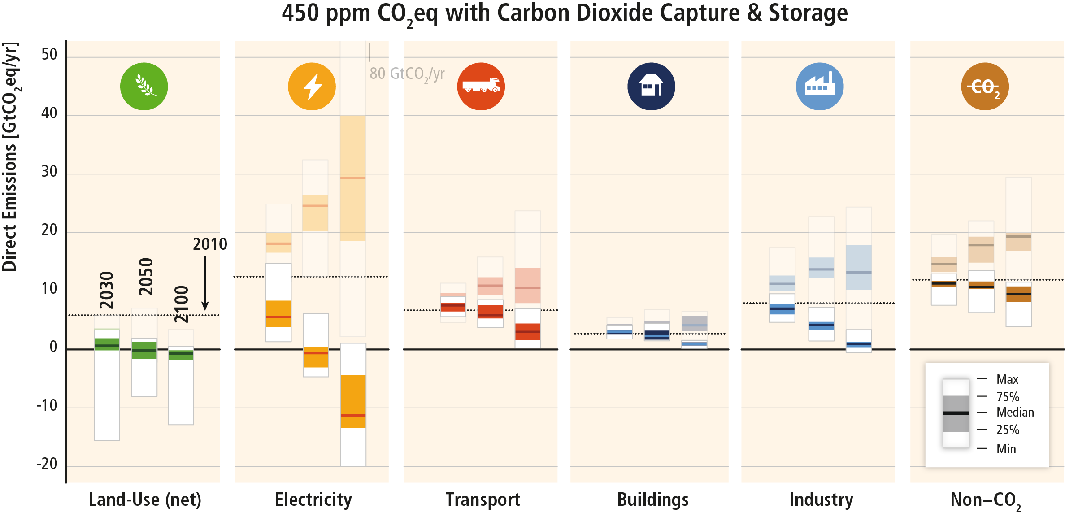
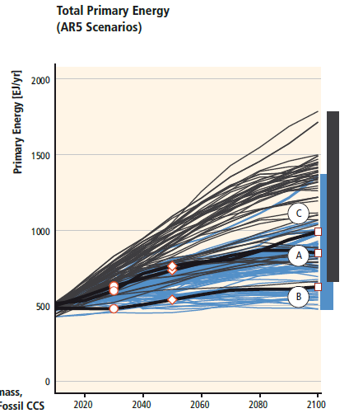
IPCC experience in using structured projections. IPCC. WGIII. 5AR.
“Mirror type” development
While the ranges are quite large, the directions of change are similar for similar targets and sets of policies

Slide 9
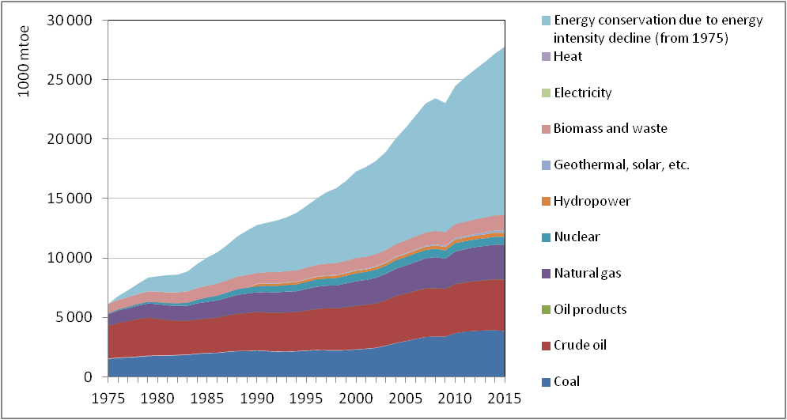
How ‘small’ at a small scale becomes ‘large’ at a larger scale. Energy efficiency has become the major resource to provide energy services
The important issues are as follows:
Do we have the will to change?
What are the limits of change?
Can we change the limits of change?
Do we have an appropriate knowledge of the system’s feedbacks and limitations and do we account for them?
Do we have the required imagination to see how ‘small’ can become ‘large’ or vice versa?
Do we account for environmental externalities and (the loss of) ecosystem services?
Is economic growth exogenous and independent from energy systems evolution?
Is technological progress exogenous and autonomous?
Energy efficiency contribution
In 2000-2015, energy efficiency improvements in IEA countries saved:
  451 mtoe of final energy
  770 mtoe of TPES (which is more than Russia’s annual energy use and 35% more than Russia’s 2016 oil and gas export)
  $US 540 billion in energy costs (which is 3.5 times Russia’s 2016 oil and gas export revenues)
EU-member countries deploy nearly 2,500 EE policies

Slide 10
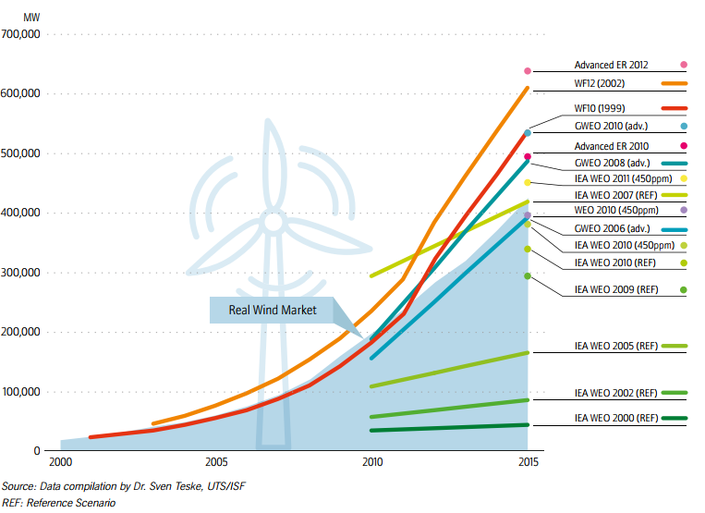
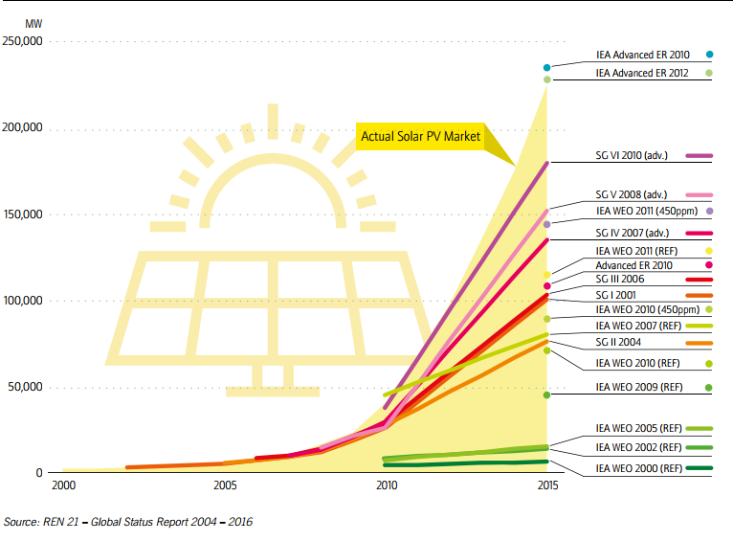
New history. REN development has swept away any and all projections and forced to liberate minds for new – and much higher – ones.
‘Green’ dreams are becoming reality and fuel suppliers’ nightmare
Evolution of wind and solar projections versus real development
How far do we need to look into the future? High inertia and fast new tech penetration. On the 2030-2035 time horizon, many of the risks do not manifest. We need to look at least to 2050 to see how ‘small’ on the small scale becomes ‘large’ on a larger scale. How far can we see? Major trends and risks will have manifested by 2050. We need models (‘time machines’) to see them

Slide 11
Triangle: economic growth – energy prices – energy efficiency
Economic growth, energy efficiency progress and energy prices are all interconnected
The economy-wide sustainable range of energy spending relative to GDP was found to be 8±2%
Stability of energy expenditures share implies that for the whole cycle (25-33 years needed to adjust to a price shock) real energy price escalation is either fully compensated by energy intensity reduction or energy price shocks are followed by energy price declines
Deviations of energy costs shares from the constrained range are possible, yet only for a limited time
It peaks after a price shock depresses economic growth and injects more strength into price elasticity thus preventing energy supplier from getting additional revenues with further price escalation
It drops to a minimum when falling prices undermine the ability of energy suppliers to meet rebounding demand given growing production costs. At either point, the evolution of relative energy expenditures stops to be reversed
The ‘rule of gravitation’ is: for the whole cycle real energy prices may grow only as much as energy intensity declines, i.e. ‘energy efficiency first’

Slide 12
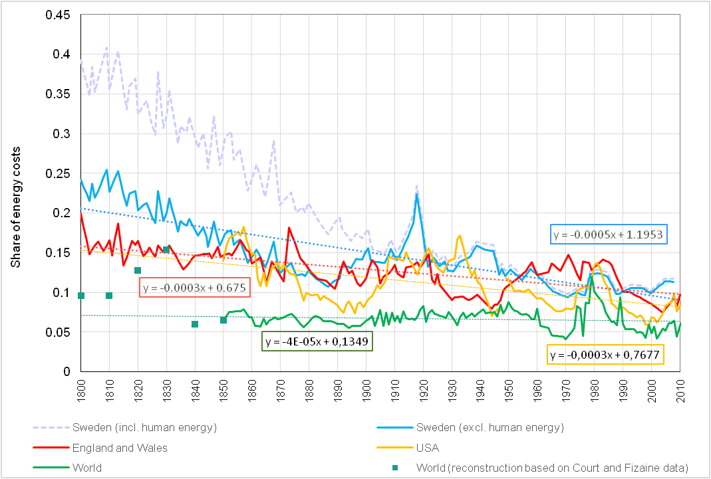
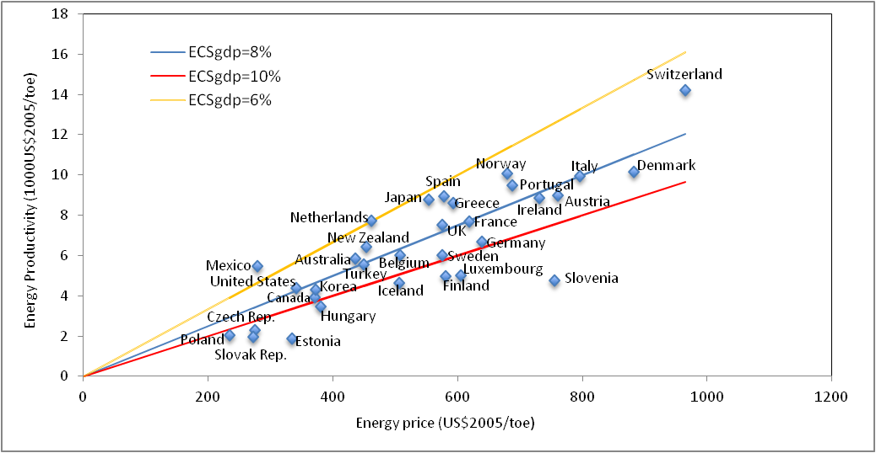
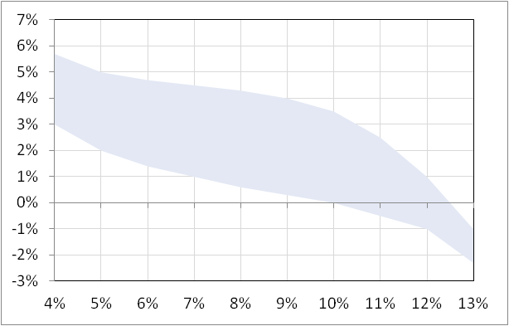
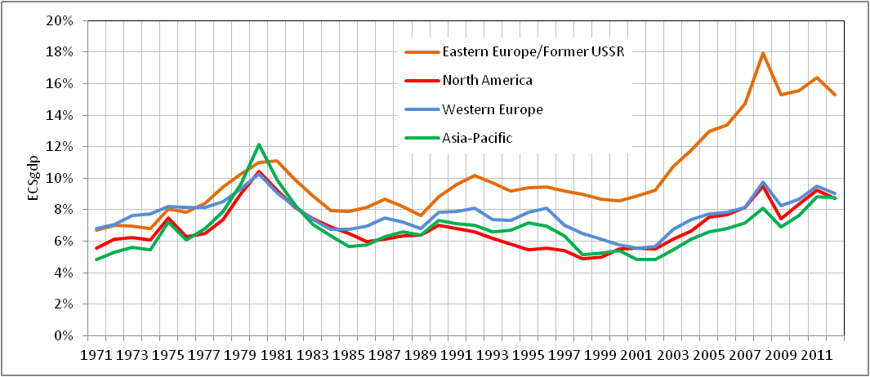
Countries with higher average energy prices have proportionally higher energy productivity or lower energy intensity
1800-2010
Bashmakov’s constant – the share of energy spending in the income is similar across countries and across time scales, irrespective of energy prices.
After ECS exceeds the threshold, the economic growth is depressed and price elasticity escalates. The ‘wing’ function
1971-2012
Energy affordability (sustainable) zone –Each additional 1% of ECS reduces GDP growth rates by 0.45%
1971-2012
Each additional 1% of ECS brings GDP growth rates down by 1%
Low energy prices lock-in technological backwardness.
For the purpose of improving energy affordability, additional income generation is more important, than keeping energy prices low

Slide 13
Models very seldom reflect energy costs and ECS, or account for the ‘wing’ function, asymmetric energy price elasticities, and ‘EG-EE-EP Triangle’ effects. In the end, rates of EE progress set the “limits of growth”
GDP and TFP growth reversely depends on ESC. The knowledge of ESC thresholds is crucial to reflect this dependence
In the long-term, energy intensity declines as much as real energy prices grow. There are many ways to respond via technological and structural changes, including energy outsourcing
Rates of EE change in a given time frame are limited. If the growth of energy prices goes beyond these limits, in the long-term they will go down to fit the rates of EE evolution
GDP growth
This triangle effects are important, including taking account of carbon pricing
ECS
Energy intensity
Energy prices
Whenever ECS reaches a high, GDP growth slows down, EE and REN deployment accelerates. Whenever ECS comes too low, EE rates decline while GDP growth escalates. Models very seldom account for ECS and for the ‘triangle’ and ‘wing’ effects

Slide 14
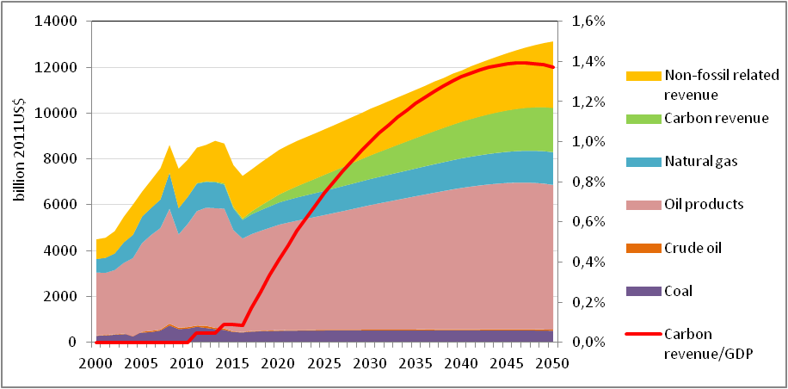
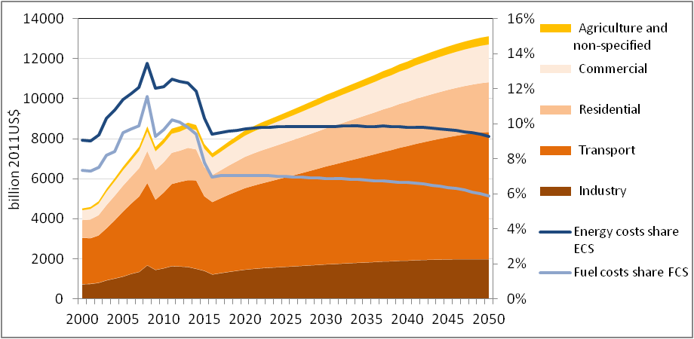
Low-carbon ‘vice’ and withdrawal of oil and gas rent.
Oil and gas revenues: big on small scale, but smaller on a bigger scale
Globally, final users will have doubled their energy spending by 2050, but:
  only a small portion of this increment will go to oil and gas suppliers, and so investment resources for future hydrocarbon developments will be limited
  a large portion of the revenue increment will go to:
    REN suppliers
    State budgets as carbon revenue

Slide 15
Past and present set future. Or don’t they?
High mortality of BAU scenarios is a result of:
failure to account for important system feedbacks,
lack of imagination in
  scaling up smalls to bigs and scaling down bigs to small,
  getting visions of the future quite different from the recent picture,
failure to use backcasting to find trajectories to approach ‘visions of the future’
failure to reflect the cyclic nature of the system evolution
Projections which come beyond the current wisdom are often rejected and not supported by the policy community.
But yesterday’s copybook maxims are very quickly found to be myths!

Slide 16
10 myths (former oracles) , which do not allow for the development of an adequate ‘vision of the future’ and development strategy.
Small on a small scale, but big on a big scale
Myth 1. Economic progress always requires more energy
Myth 2. Economic progress always requires more energy per capita
Myth 3. Oil is the major energy resource
Myth 4. Higher energy prices lead to a higher share of energy costs and loss of competitiveness
Myth 5. Carbon pricing slows down economic growth
Myth 6. REN resources are always more expensive, than those based on fossil fuel
Myth 7. A 100% REN energy system cannot be created
Myth 8. Oil and gas are the most attractive spheres for energy investments
Myth 9. Past and present shape future
Myth 10. Global economy will always need Russia’s hydrocarbons
Just recently these 10 myths were oracles

Slide 17
Future is not where it used to be!
Those who only focus on roots (the past) may miss flowering- (present) and fruits (future)
Thank you!
Center for Energy Efficiency – XXI
We give our energy to save yours!
www.cenef.ru (499) 120-9209
Moscow, 10.11.2017

